Slide 1
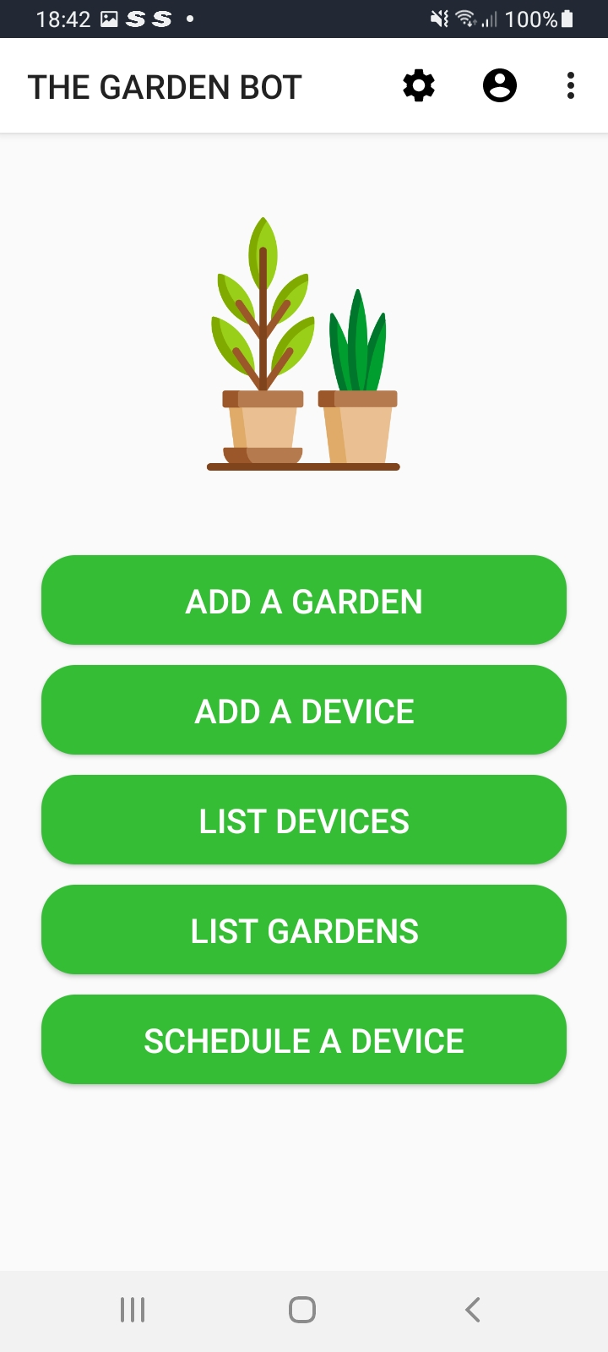
Logout
User Profile
Settings
Add A Garden
Add A Device
List Devices
List Gardens
Schedule A Device

